Slide 1
A modularized library for motion planning of robots
Chew Keng Siong @Morgan (18b9062)
Under the Supervision of Dr. Ajaz Ahmad Bhat

Slide 2

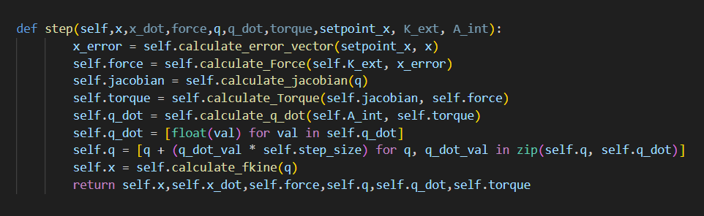

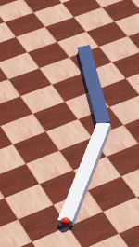
Project Goals
Create a PMP class that offers a PMP for any body chain, and with multiple parallel goals.
contribute and add to an existing library

Slide 3
What is PMP?
Passive Motion Paradigm (PMP)suggests that When you want to reach for something. Instead of meticulously planning every muscle movement, the brain learns from the body's natural behavior. It's a collaborative effort between the brain and body to find the most efficient way to move. This process leverages the body's natural dynamics to guide movements. This approach avoids the need for complex calculations and simplifies a challenging problem into a more manageable one, akin to taking a shortcut.

Slide 4
Phases of the Project
Webots
Implementation
Testing
end

Slide 5
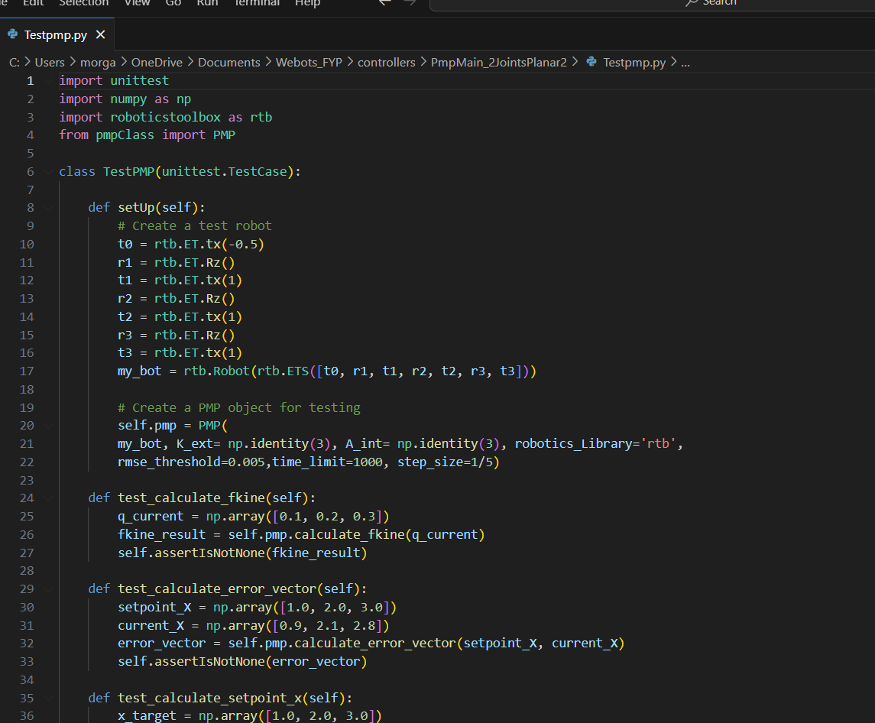
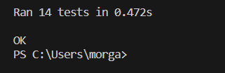
Test Cases
Validating the functionality and performance of the Passive Motion Paradigm (PMP) class

Slide 6
Components
pmpMain.py
The Driver file
pmpClass.py
Where PMP is implemented
rtbRobot.py
Creates the robot needed for calculation using RTB Library.

Slide 7
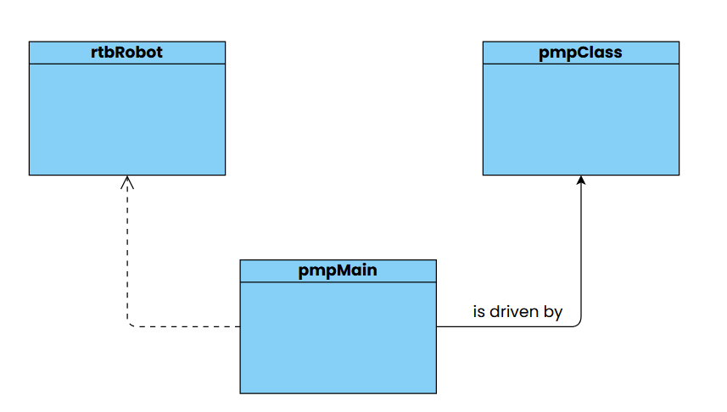
Class Diagram
Handles the representation of the robot.
Returns the motors to set the joints to.
Handles setting the joints to positions based on the results returned by the PMP class.

Slide 8
Testing the PMP class
Create a robot
Create a controller in the form of pmpMain.py
Call the pmp Class from the controller and use it to calculate the joint trajectory
Use this result to set the joints accordingly and it will reach the ball target successfully

Slide 9

Implementation in 2-Jointed Planar
Using the q-traj returned by the PMP class, It sets the joints accordingly

Slide 10
Changes to be made
Call the correct representation of the robot from rtbRobot.py
Create a new controller with the prefix pmpMain or modify an existing one that is able to set the joints for this robot. (the set_motor function)
Call the pmp Class from the controller and use it to calculate the joint trajectory
Use this result to set the joints accordingly and it will reach the ball target successfully
No changes to PMP class

Slide 11
Implementation in Another 2-Jointed Planar

Slide 12
Implementation in 3-Jointed Planar
Here instead of 2 joints, it dealing with 3 joints.
With only small changes to the pmpMain file, it should work like with the 2-joints planar.

Slide 13
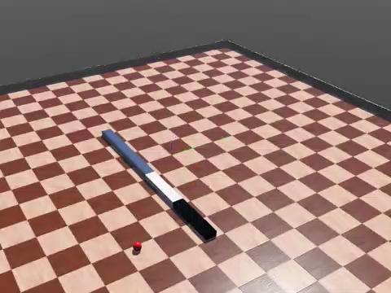
Implementation in Another 3-Jointed Planar
Here is an example of modified version of the previous robot.

Slide 14
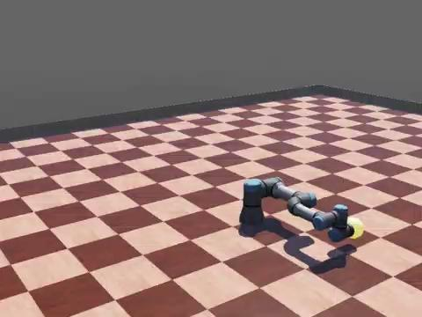
Troubles
Unable to implement into robots with 3-DOF
Requires investigations into the admittance and stiffness being passed for calculations.
Incorrect representation in the rtbRobot.py

Slide 15
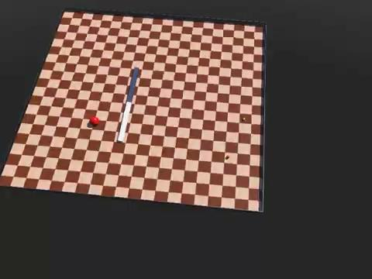
Further Implementations and Improvements
TBG is not Implemented.
Only tested with RTB library.

Slide 16
Conclusion
The PMP class is overall in need of major refactoring and even more testing is required, it is still experiencing issues with running 3D robots, hence it will require further investigation by future contributors. Hopefully these can be resolved and the final goal of pushing the class to an existing code base of a robotics library can be attained.
Notes:
Error Calculation:
x_error = self.calculate_error_vector(setpoint_x, x): Calculates the error vector between the desired position (setpoint_x) and the current position (x).
Force Calculation:
force = self.calculate_Force(K_ext, x_error): Calculates the force using the error vector and the coefficient matrix K_ext.
Jacobian Calculation:
jacobian = self.calculate_jacobian(q): Calculates the Jacobian matrix based on the current configuration (q) of the system.
Torque Calculation:
torque = self.calculate_Torque(jacobian, force): Calculates the torque using the Jacobian matrix and the force.
Velocity Calculation:
q_dot = self.calculate_q_dot(A_int, torque): Calculates the velocity (q_dot) using the torque and the coefficient matrix A_int.
Integration and Position Update:
q_dot = [float(val) for val in q_dot]: Converts the velocity values to floating-point numbers.
q = [q + (q_dot_val * self.step_size) for q, q_dot_val in zip(q, q_dot)]: Updates the configuration (q) based on the calculated velocity using numerical integration.

Slide 17

End
Chew Keng Siong @Morgan
18b9062 @ubd.edu.bn

